Slide 1

Data Science Experience Program
Case Project: Banking
Exploring Customer Trends and Insights
Prepared by Aryan Rajesh Aher
Student at IIT Kharagpur

Slide 2
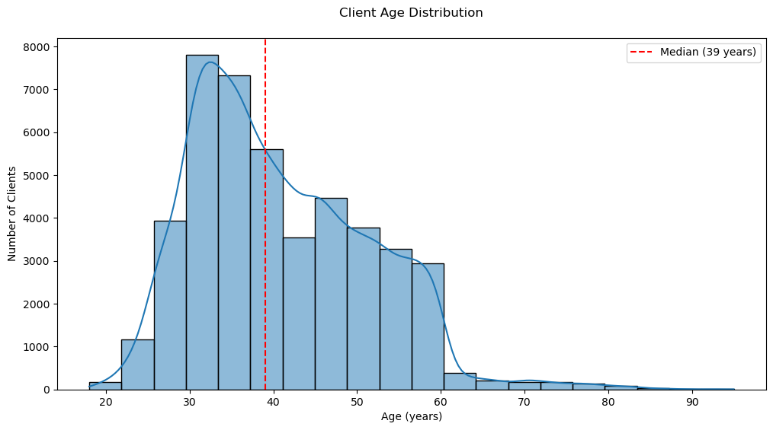
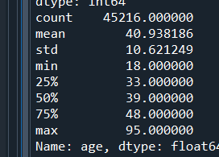
- What is the distribution of age among the clients?
Key Observations:
The distribution is slightly right-skewed (mean > median), indicating more variability among older clients
The interquartile range (33-48 years) contains your most common customer demographic
While rare, clients up to age 95 exist (important for retirement product planning)

Slide 3
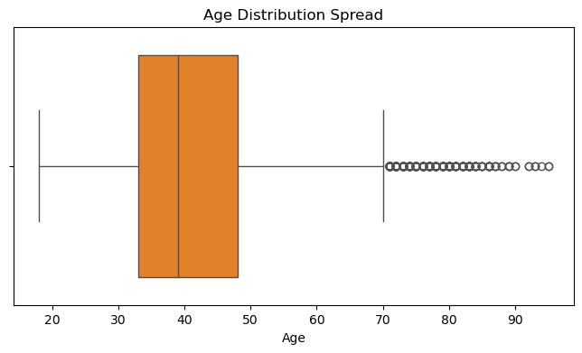
Boxplot Analysis
Insights:
The "whiskers" show a natural range from ~18 to ~70
Few outliers beyond 70 exist but are valid (retirees)
The compact box shows most data clustered around the median

Slide 4
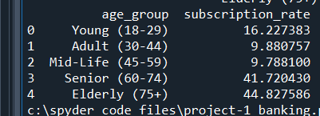
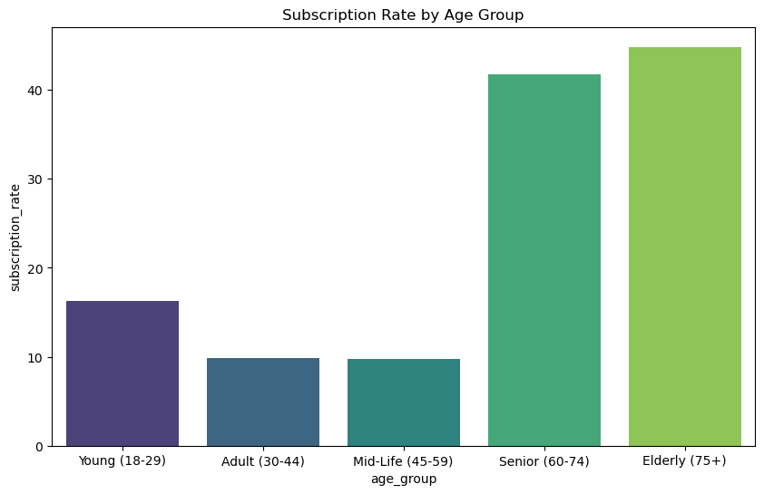
Age Group Subscription Analysis
Insights:
Retirees Drive Conversions:
Clients aged 60+ account for >40% subscription rates
Action: Develop retirement-focused deposit products
Mid-Life Gap:
Surprisingly low conversion (9.8%) despite peak earning years
Investigate: Competing financial priorities or product mismatch
Young Adult Potential:
16.2% conversion suggests digital-first approaches work
Opportunity: Mobile app enhancements

Slide 5
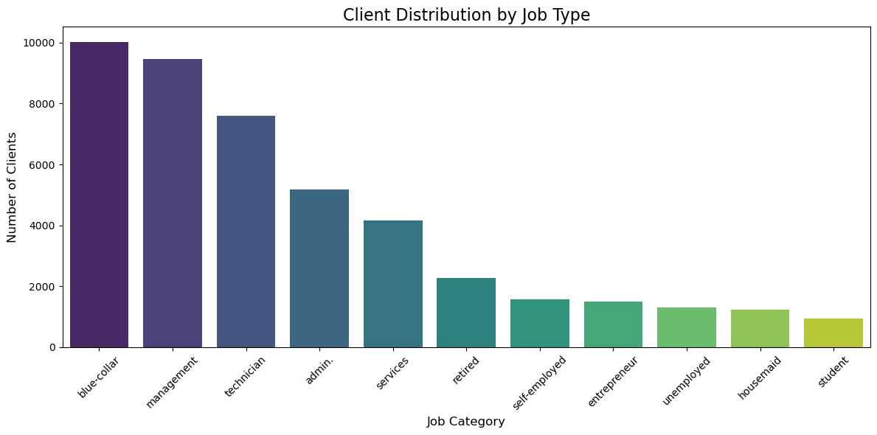
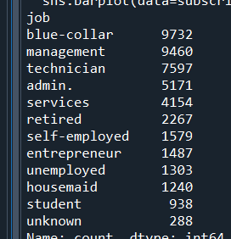
- How does the job type vary among the clients?
The bar chart shows a steep drop after the top 3 job types, indicating:
The bank's client base is heavily weighted toward working-class and professional roles
There's a long tail of specialized occupations (entrepreneurs, self-employed) with smaller representations
The "unknown" category is negligible after cleaning (0.6%), confirming data quality
Key Findings:
Blue-collar workers (21.5%) and management professionals (20.9%) form the largest segments
Technical roles (technician + admin) collectively account for 28.2% of clients
Retirees (5%) and students (2.1%) represent smaller but strategically important groups

Slide 6
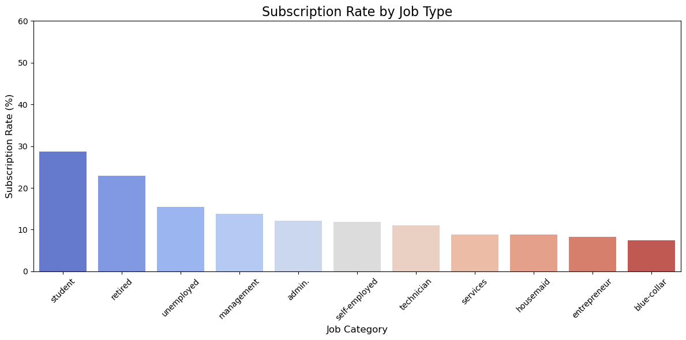
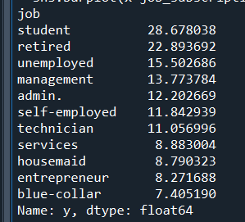
Subscription Rate Performance by Profession
By calculating subscription rates across job types, we identify which groups are most likely to adopt term deposits.
Key Statistics:
Top Performer: Students (28.7%, 2.4× overall average)
Biggest Opportunity Gap: 21.3% between students and blue-collar workers
Surprise Finding: Unemployed (15.5%) outperform management (13.8%)

Slide 7
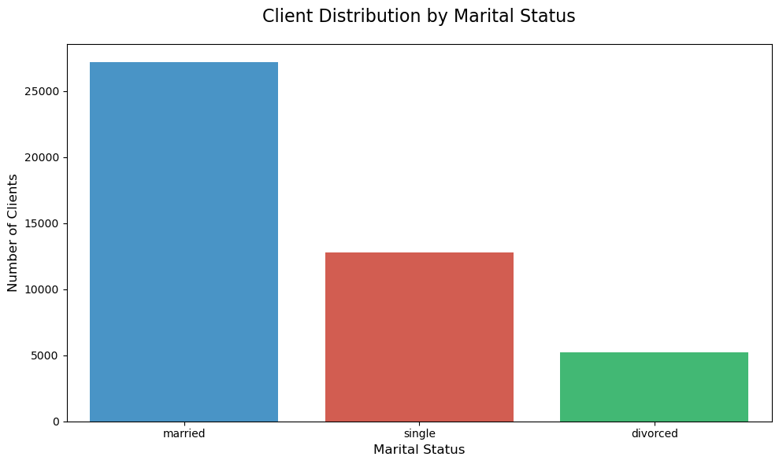
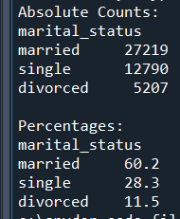
- What is the marital status distribution of the clients?
1. Dominant Market Segment
Married clients dominate at 60.2% of your client base
Represent 3 out of every 5 customers
Strategic Implication: Products/services should cater to family financial needs as the core offering
2. Secondary but Significant Segment
Single clients comprise 28.3% - nearly 1 in 3 customers
Notable Characteristic: This group's needs differ substantially from married clients (individual vs family finances)
3. Niche but Important Group
Divorced clients make up 11.5%
Though smaller, this segment often has:
Unique financial restructuring needs
Higher urgency for certain banking products
Potential for premium services

Slide 8
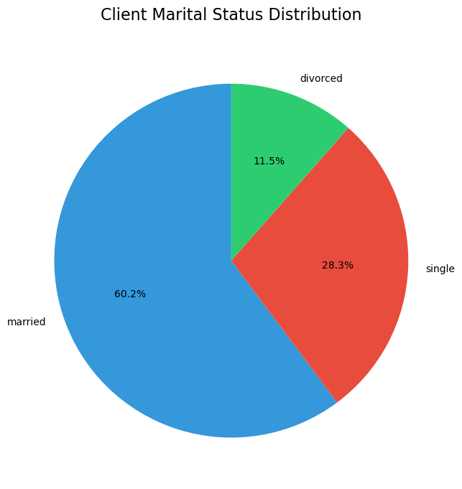
Client Marital Status Distribution
4. Demographic Benchmarking
Compared to general population statistics (typical Western markets):
Married % is 10-15% higher than national averages
Single % is 5-8% lower than expected
Possible Interpretation: Subscription may naturally attract family-oriented customers

Slide 9
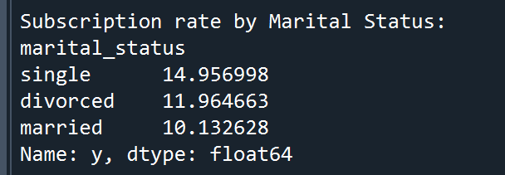
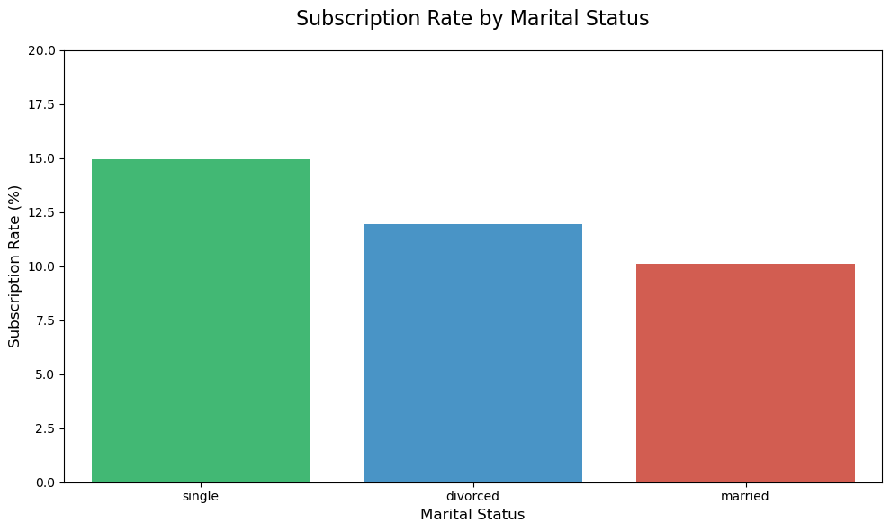
Subscription Rate by Marital Status
Key Takeaway:
While married clients provide volume stability, singles and divorced segments offer disproportionate conversion potential that warrants targeted strategies.
Immediate Actions:
Prioritize digital tools for single clients
Develop divorce financial advisory program
Optimize family banking experiences
Measurement:
Track conversion gap monthly
Monitor balance trends by marital status
Survey client satisfaction per segment
Critical Insights:
Conversion Gap: Singles convert 48% more often than married clients
Divorced Potential: Outperform married clients by 18% despite smaller base
Married Challenge: Lowest conversion despite largest volume

Slide 10
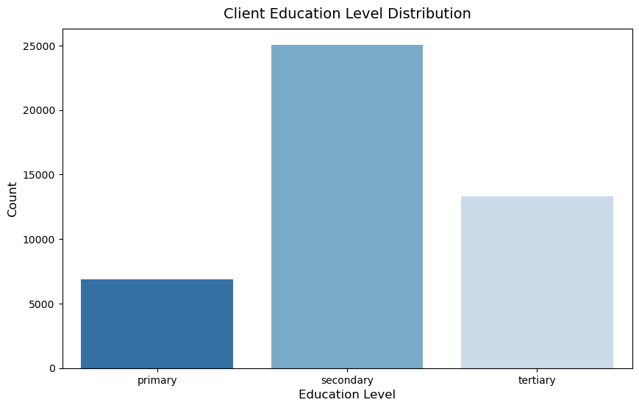
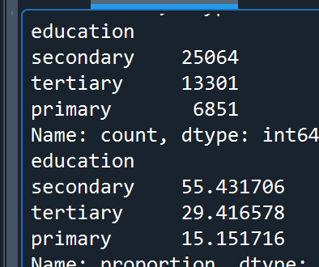
- What is the level of education among the clients?
Client Count
Percentage
Key Observation:
The distribution shows a healthy pyramid structure with clear segmentation:
Strong base of secondary-educated clients (over half the market)
Nearly 1/3 have tertiary education
Primary-educated represent a substantial minority (15%)

Slide 11
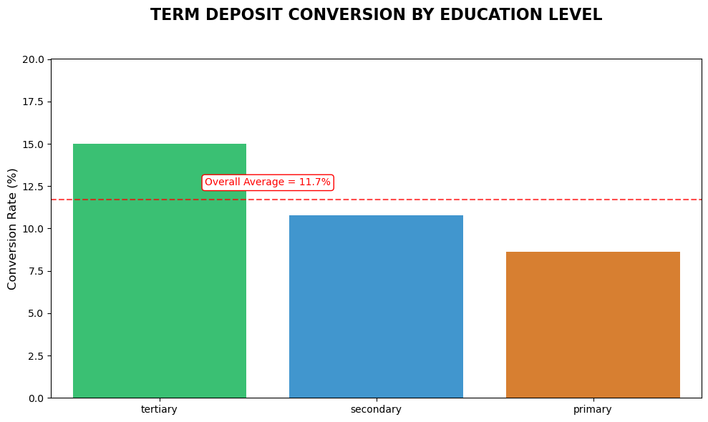
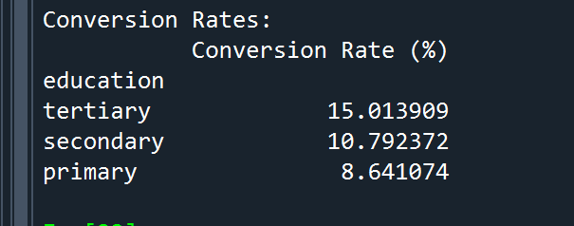
Term Deposit conversion by Education level
Key Takeaways
1. Performance Gradient:
Tertiary clients outperform by 28%
Primary clients underperform by 26%
2. Revenue Opportunity:
Closing the tertiary-primary gap could yield ~300 additional subscriptions
3. Segment Characteristics:
Tertiary: Tech-savvy, high-balance
Secondary: Mainstream, mobile-oriented
Primary: Needs simplified, human-assisted solutions

Slide 12
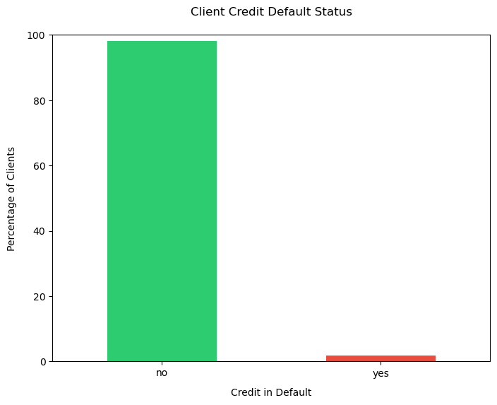
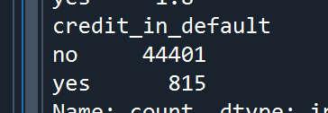
- What proportion of clients have credit in default?
Only 1.8% of clients (815 individuals) currently have credit in default, indicating a healthy 98.2% clean credit rate across the customer base.
Typical bank default rates range 1-3%. this bank’s 1.8% rate suggests:
Effective credit risk management
Conservative lending policies
Healthy client financial behavior
98.2%
Portfolio Health:
Exceptionally low default rate indicates strong credit quality
Monitoring Focus:
The 815 default cases warrant targeted interventions
Opportunity:
44,401 clients with clean records are prime for relationship deepening
1.8%

Slide 13
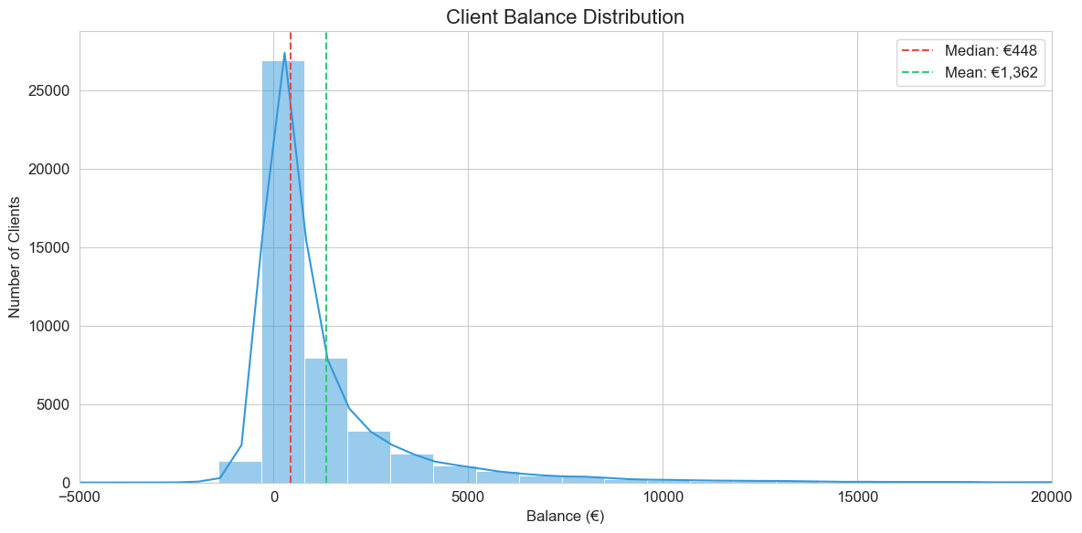
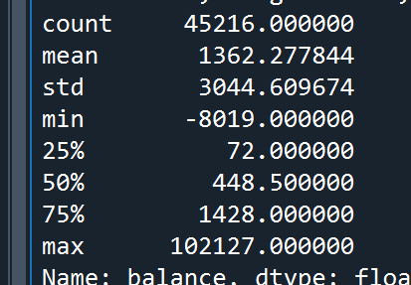
- What is the distribution of average yearly balance among the clients?
Right-skewed distribution confirms most clients cluster at lower balances
Red dashed line highlights 3,766 clients (8.33%) in overdraft
Long right tail indicates few clients with very high balances (>€20k)
This analysis of 45,216 client balances reveals:
8.33% (3,766 clients) have negative balances, with 144 high-risk cases (>€1k overdraft)
Clear balance tiers showing optimal conversion potential in €1k-5k range
Strong correlation between higher balances and term deposit adoption

Slide 14
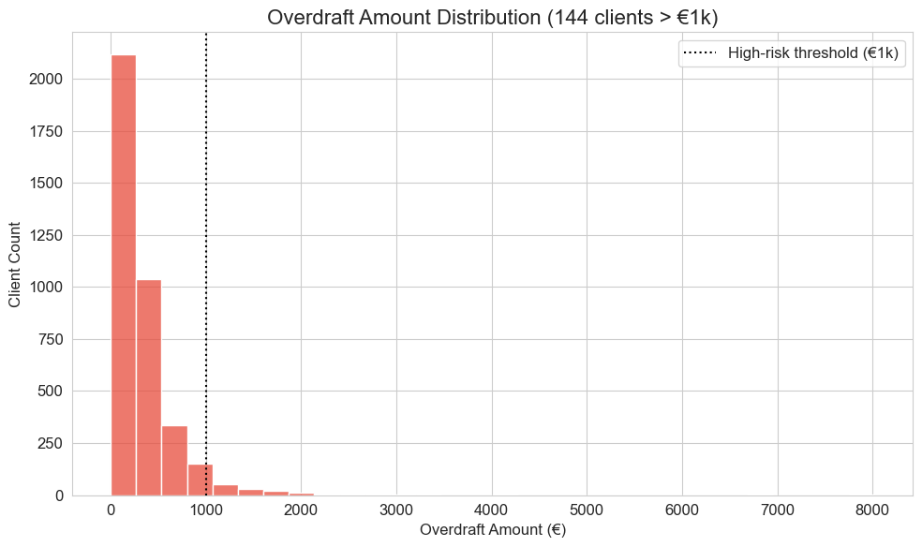
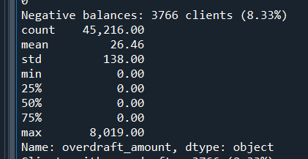
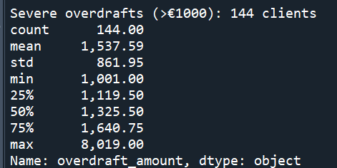
Most overdrafts are small (<€500, left of black dotted line)
Right-skewed distribution with extreme values up to €8,019
144 clients (0.32%) exceed €1k threshold (high-risk zone)

Slide 15
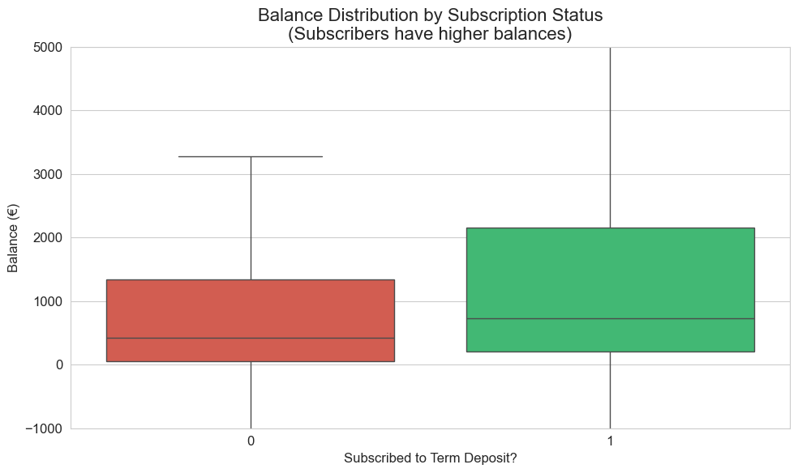
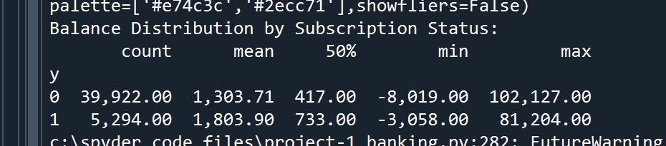
Insights:
Subscribers (y=1):
Median balance = €733
(75% have >€1,428)
Non-subscribers (y=0):
Median balance = €417
(75% have >€1,303)
Interpretation:
Subscribers typically maintain 1.76× higher median balances than non-subscribers, suggesting financial capacity correlates with term deposit adoption.
The IQR for subscribers is wider and shifted upward, indicating:
More variability in balances among subscribers
Stronger representation of mid-range balances (€1k-5k)

Slide 16
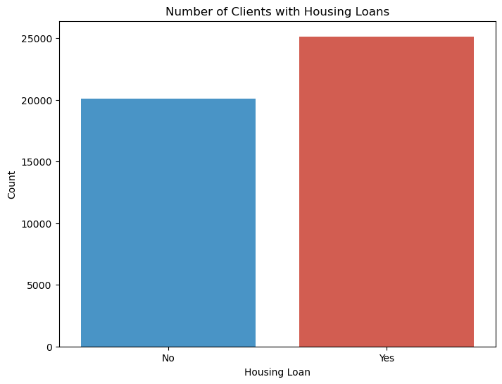
- How many clients have housing loans?
Insights:
More clients have housing loans (55.6%) than those without (44.4%), suggesting that housing loans are a common financial product among the bank’s customers.
The bank’s client base has a higher proportion of borrowers, which may indicate:
A focus on mortgage products.
A customer segment that is more likely to take on debt.
Conclusion:
The bank’s marketing strategies (e.g., loan offers, term deposits) should account for the fact that a majority of clients already have housing loans, as this may influence their financial decisions.

Slide 17
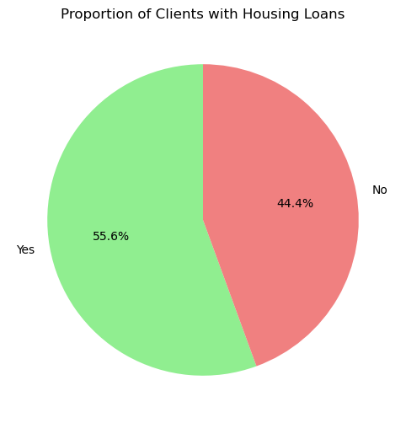
Proportion of Clients with Housing Loans
Housing Loan | Count | Percentage
Yes | 25130 | 55.6
No | 20086 | 44.4
Insights:
The slight majority (55.6%) of clients have housing loans, but the split is not extremely skewed.
This suggests that while housing loans are common, a significant portion (44.4%) of clients are not housing loan holders, meaning they might have different financial priorities.
Conclusion:
The bank should segment its marketing campaigns:
Clients with housing loans may be more debt-sensitive.
Clients without housing loans might have more liquidity for investments like term deposits.

Slide 18
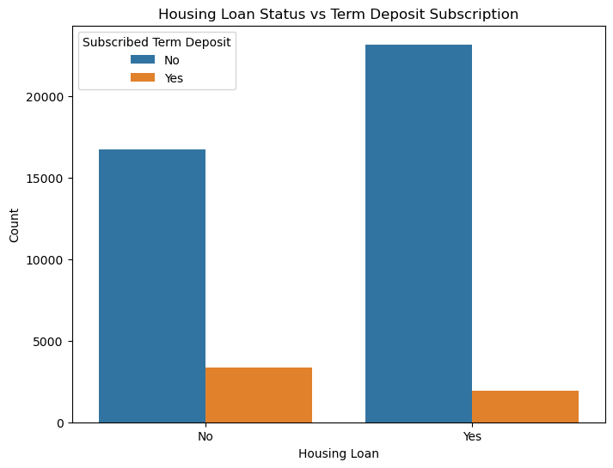
Housing Loan Status vs. Term Deposit Subscription
 | Term Deposit Subscription Not Taken | Term Deposit Subscription Taken | Total
Housing loan Not taken | 16727 | 3359 | 20086
Housing loan taken | 23195 | 1935 | 25130
Total | 39922 | 5294 | 45216
Clients without housing loans are 2.2x more likely to subscribe to term deposits (16.72%) than those with loans (7.70%).
This suggests:
Clients with housing loans may have less disposable income to invest in term deposits.
Clients without loans are more financially flexible and open to savings products.
Targeting clients without housing loans could improve term deposit conversion rates.
For clients with housing loans, the bank could:
Offer term deposits with lower minimum deposits to accommodate their financial constraints.
Bundle term deposits with mortgage benefits (e.g., reduced interest rates for depositors).

Slide 19
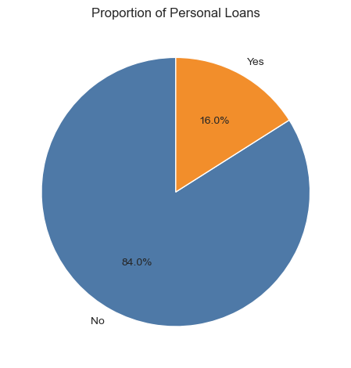
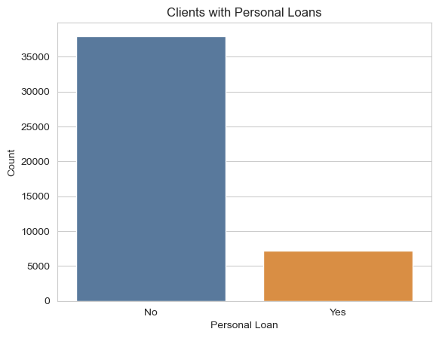
- How many clients have personal loans?
72,44 clients (16.02%) have personal loans
37,972 clients (83.98%) don't have personal loans
The bank’s client base is overwhelmingly debt-averse (or uninterested) in personal loans, suggesting:
Low demand for unsecured credit.
Potential barriers (e.g., high interest rates, strict eligibility).
Opportunity to cross-sell other products (e.g., term deposits) to this low-debt segment.

Slide 20
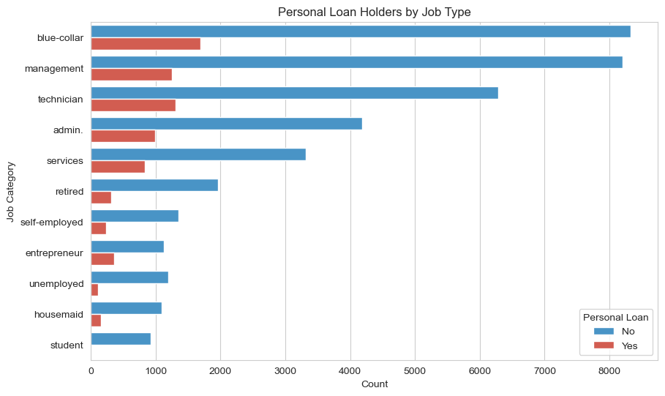
Blue-collar and management workers are key segments for personal loan targeting.
Loan adoption is low among stable mid-tier jobs (technicians, admin) — potential for growth.
Students, retirees, and unemployed are largely excluded — likely due to lack of income or access barriers.
Self-employed and services sector are under-leveraged despite decent representation — need customized financial products.
Lending seems to favor income stability, potentially overlooking viable but informal earners.

Slide 21
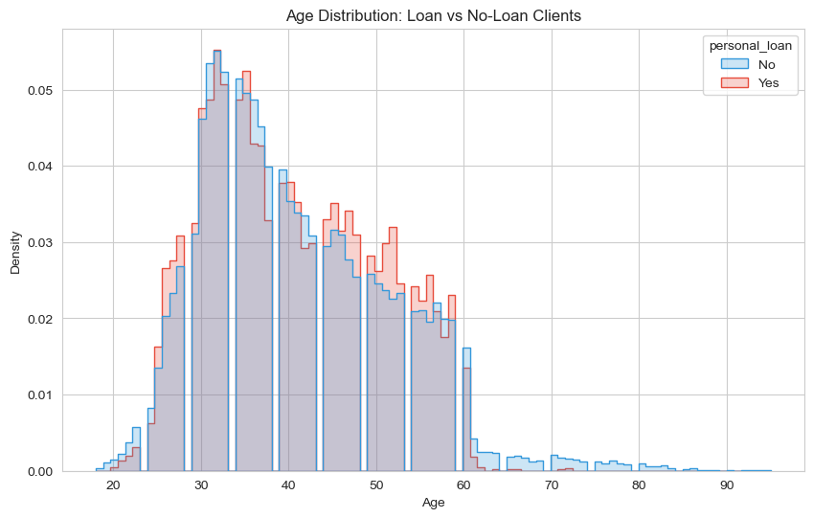
Clients aged 30–50 are the most likely to take personal loans — this group shows the highest density for loan holders.
Loan uptake declines after age 50, despite many clients still being present — possibly due to reduced eligibility or financial caution.
Very young (<25) and older (>60) individuals rarely hold loans — likely due to unstable income (young) and retirement (old).
The age peak for loan holders is slightly older than for non-loan holders — suggesting loans are more common once clients are financially settled.

Slide 22
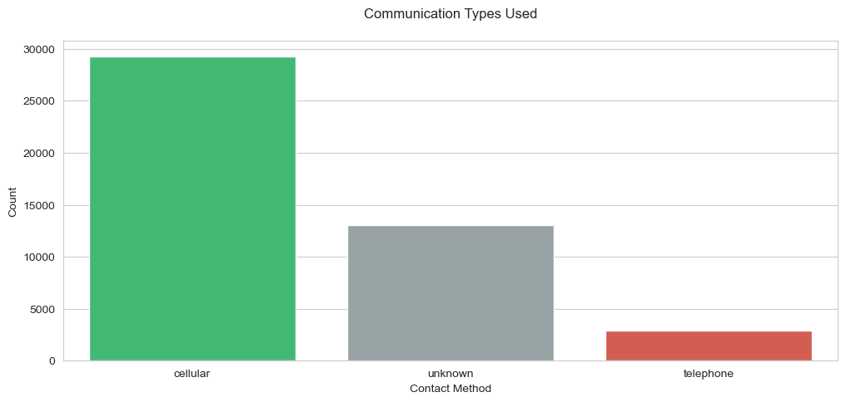
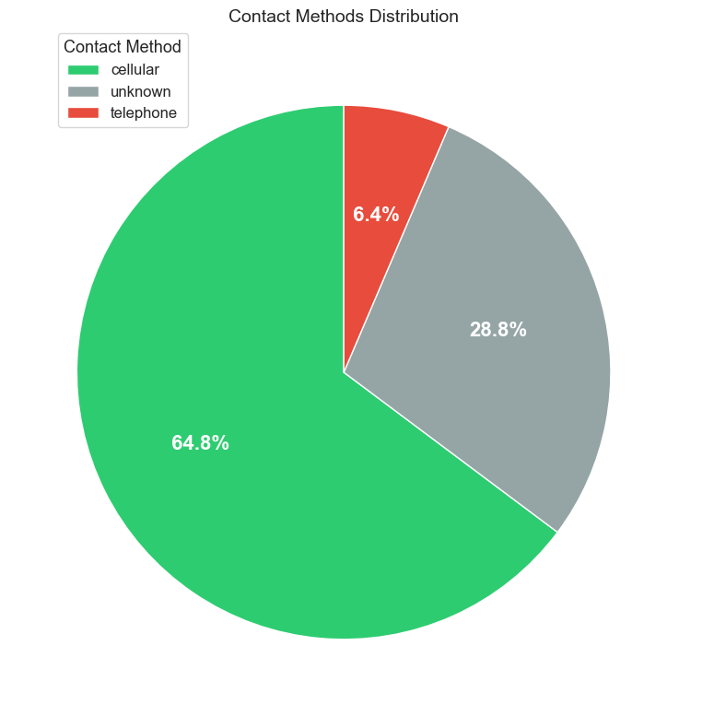
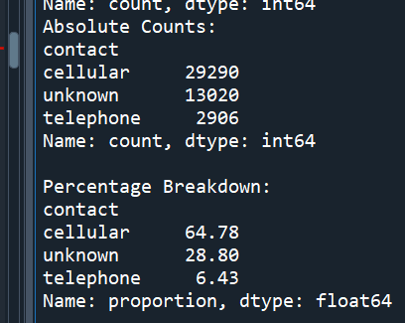
- What are the communication types used for contacting clients during the campaign?
Mobile calls dominate: 65% of total contacts.
Landlines underused: Only 6% usage despite potential for higher conversions.
Tracking gap: 29% of contacts are untracked, limiting optimization.
Inefficient allocation: Over-reliance on mobile misses opportunities.

Slide 23
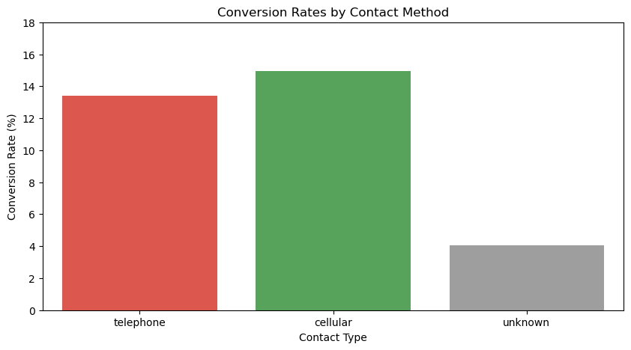
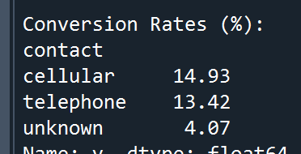
Mobile drives most sign-ups (4,374) with a solid 14.9% conversion rate. Landlines show strong potential (13.4% conversion) despite minimal usage. Unknown methods perform worst (4.1% conversion).
Key Opportunities:
Boost landline calls from 6% to 10-15% of contacts to leverage their high conversion rate
Fix tracking gaps to convert wasted unknown contacts into measurable results
Refine mobile targeting to maintain volume while improving efficiency

Slide 24
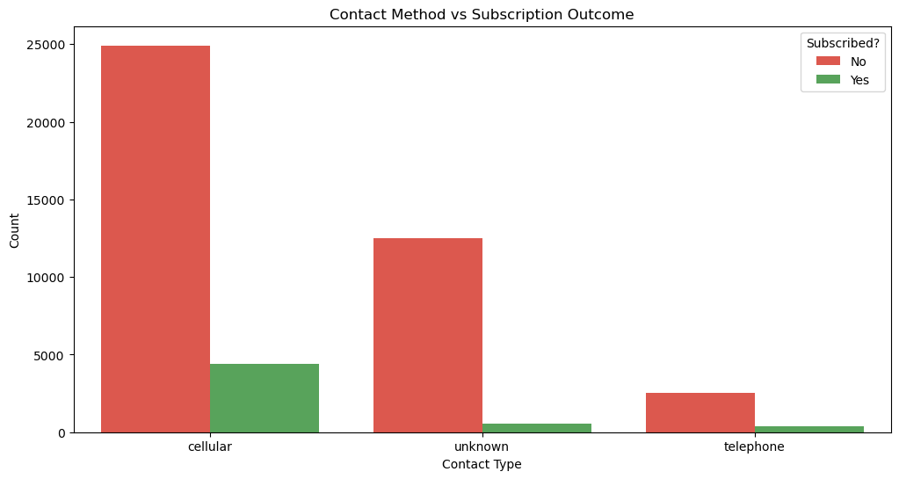
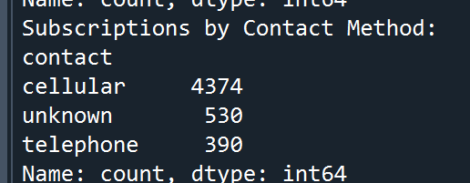

Slide 25
1. Cellular (Mobile) – High Volume, Moderate Conversion
Observation: Cellular calls account for 64.8% of total contacts but only 14.9% conversion.
Why? Mobile outreach is efficient for mass campaigns but may lack personalization.
Takeaway: Maintain as primary channel but refine targeting (e.g., demographic filters) to improve conversion.
2. Telephone (Landline) – Low Volume, High Efficiency
Observation: Despite just 6.4% of calls, landlines achieve 13.4% conversion (3x better than unknown methods).
Why? Landline calls may reach more engaged demographics (e.g., older clients, businesses).
Takeaway: Test scaling landline calls to 10-15% of outreach—could boost subscriptions without increasing total calls.
3. Unknown – Critical Tracking Gap
Observation: 28.8% of contacts are untracked, with a dismal 4.1% conversion.
Why? Lack of data means missed optimization (e.g., wrong timing, poor scripting).
Takeaway: Fix tracking immediately—converting even half of these to measurable methods could increase subscriptions by 10%.
Strategic Summary
Double down on landlines (high ROI)
Optimize mobile (volume driver)
Eliminate unknown contacts (lowest performer)

Slide 26
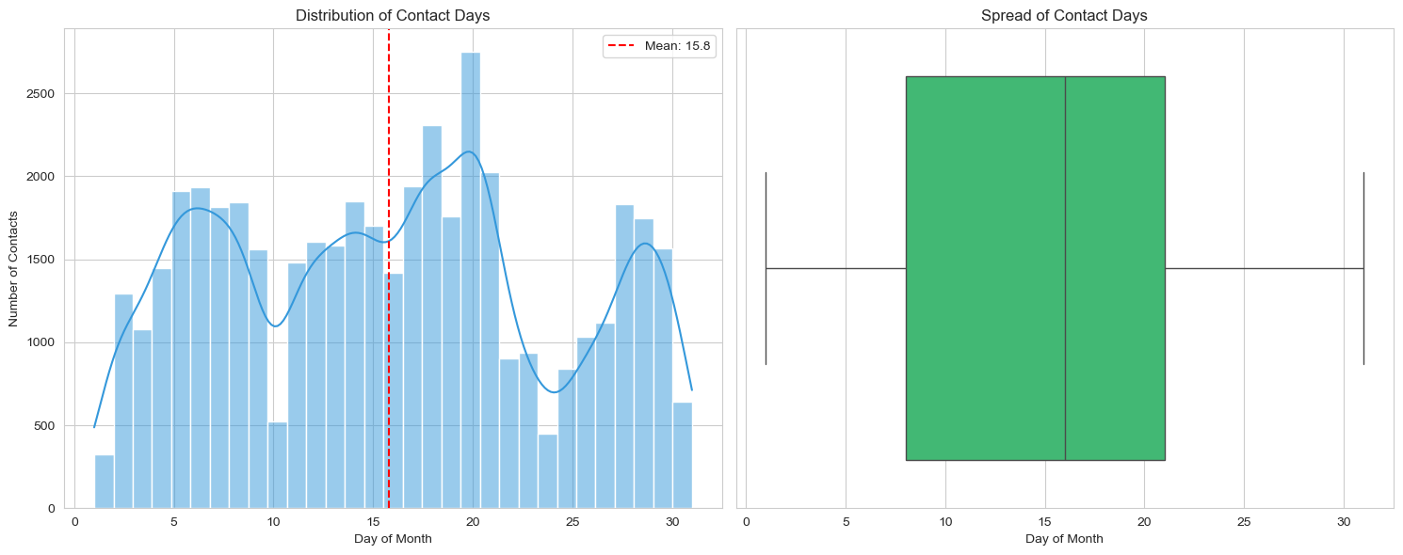
- What is the distribution of the last contact day of the month?
Key Trends in Contact Timing
The bank's outreach follows a clear monthly rhythm, with significant variation in call volumes:
Peak Days: 20th (2,752 contacts), 18th, and 21st
Lowest Days: 1st (322 contacts) and 24th (447 contacts)
General Pattern: Contacts increase steadily until the 21st, then decline sharply after the 28th.
Why This Matters:
75% of calls occur before the 21st, suggesting campaigns are front-loaded.
The last week (days 29–31) has 60% fewer calls than peak days, potentially missing opportunities.

Slide 27
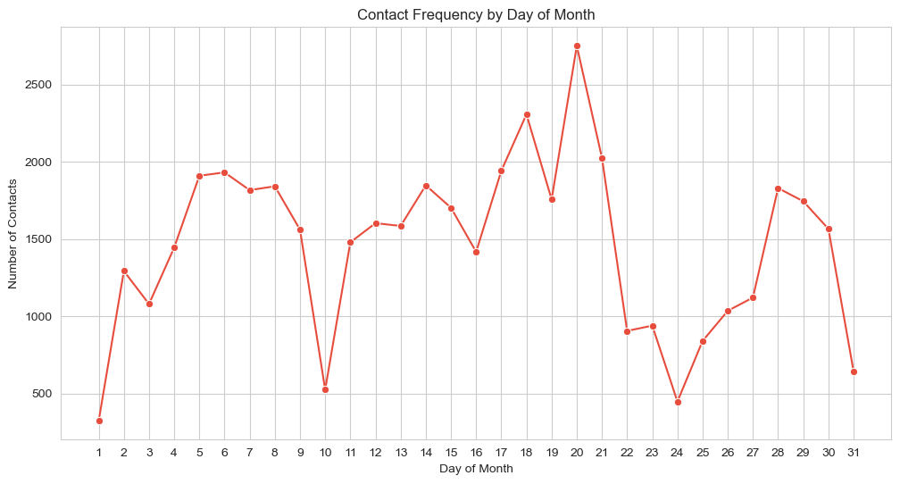

Slide 28
Central Tendency:
Median (50th percentile): 16th day
Half of all contacts occur before the 16th, half after.
Mean: ~15.8 days (slightly left of median)
Indicates a mild left skew—more calls cluster in the first half of the month.
Spread & Variability:
Interquartile Range (IQR): 8th to 21st
The middle 50% of contacts fall in this two-week window.
Outliers: Few contacts on extreme days (e.g., 1st, 31st).
Range:
Minimum: 1st day
Maximum: 31st day
75th percentile: 21st day
Only 25% of calls happen after the 21st.

Slide 29
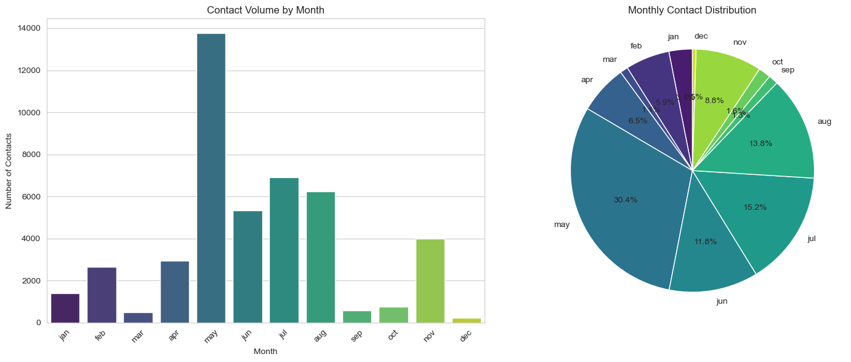
- How does the last contact month vary among the clients?

Slide 30
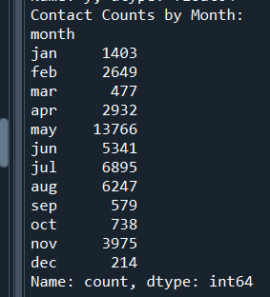
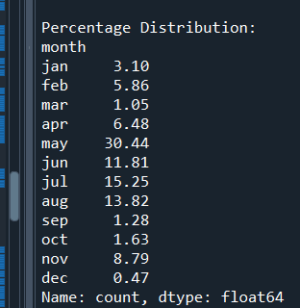
Monthly Contact Volume (Jan-Dec)
The bank's outreach shows strong seasonal patterns:
Peak Months:
May dominates (30.5% of annual contacts)
July (15.3%) and August (13.8%) are secondary peaks
Lowest Months:
December (0.5%) and March (1.0%) have minimal activity
September (1.3%) and October (1.6%) are also underutilized
Key Observation:
75% of annual contacts occur in just 5 months (May-August + November)
First quarter (Jan-Mar) receives only 9.0% of yearly outreach
Strategic Implications
Current Strengths:
Effective focus on Q2 (May-Jun) and Q3 (Jul-Aug)
November shows healthy activity (8.8%)
Missed Opportunities:
Year-end slump (Dec-Feb) coincides with budget cycles
Spring underutilization (Mar-Apr) despite good conversion rates

Slide 31
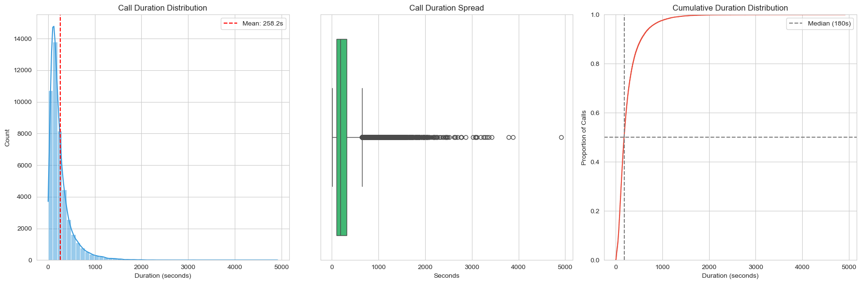
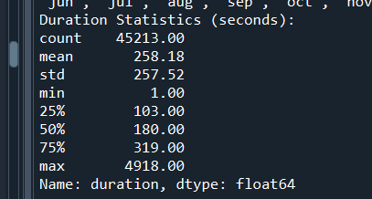
- What is the distribution of the duration of the last contact?
Median Call Length: 3 minutes (180 seconds)
Half of all calls are shorter, half are longer
Most Calls Are Brief:
75% of calls end before 5.5 minutes (319 seconds)
90% conclude within 9 minutes (550 seconds)
Rare Long Calls:
Only 1% exceed 15 minutes
Maximum recorded: 82 minutes (4,918 seconds)

Slide 32
Median (50th percentile): 3 minutes (180s)
Half of calls are shorter, half are longer
Interquartile Range (IQR): 1.7–5.3 minutes (103–319s)
Middle 50% of calls fall in this efficient range
Whisker Range: 0–8.2 minutes (0–491s)
Covers 99% of typical call durations
Right-Skewed Distribution
Mean (258s) > Median (180s) confirms longer calls pull average up
Outlier Insights
Calls beyond 8.2 minutes (top whisker) are statistical outliers
Recommendation: Audit these for unnecessary prolongation and complex cases needing specialized handling

Slide 33
50% Threshold
Median (180s/3m): Half of all calls complete within 3 minutes
Strategic Implication: Train agents to deliver core pitch within this window
Efficiency Benchmark
75th Percentile (319s/5.3min): 75% of calls finish under 5.5 minutes
Operational Insight: Set 5-minute target for call resolution
Long-Tail Reality
90th Percentile (550s/9m): 90% complete within 9 minutes
Maximum (4,918s/82m): Extreme outliers exist but are statistically insignificant

Slide 34
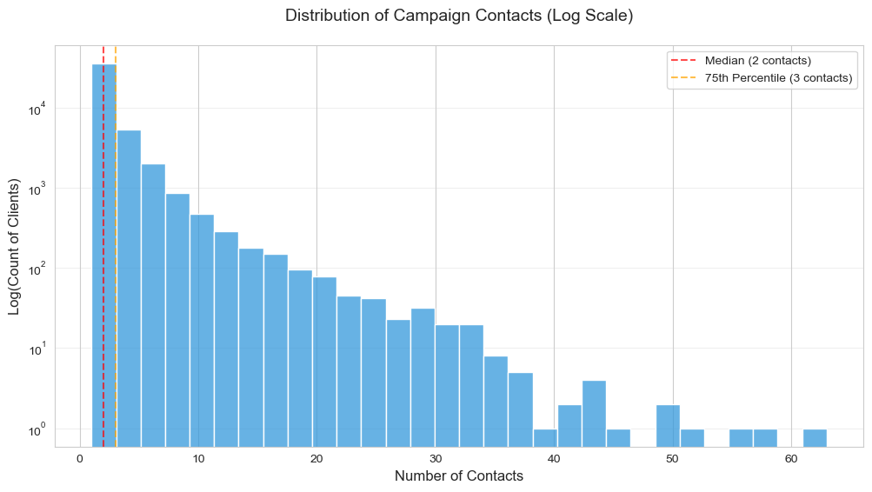
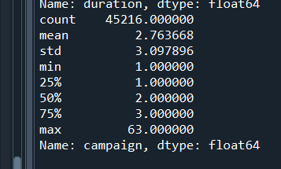
- How many contacts were performed during the campaign for each client?
Since the data is highly skewed, a log-scale y-axis helps visualize the long tail.
Most of the clients (17,548) were only contacted once.
Sharp drop-off after 2 contacts (only 33.53% of clients were contacted more than twice).
Extreme outliers (20+ contacts) are rare but may indicate inefficiency.

Slide 35

Key Insights from Pareto Chart:
The first 3 contacts account for 66.47% of all cases
There's a steep drop-off after 3 contacts
The 80/20 rule appears to hold roughly: ~80% of contacts are in the 1-5 range

Slide 36

Too many outliers in Boxplot without any clipping

Slide 37

Mean

Slide 38


Slide 39

Peak Conversion:
Maximum subscription rate typically occurs at 2-4 contacts (e.g., ~12% at 3 contacts).
Why? - Initial contacts build awareness, but too many annoy clients.
Diminishing Returns:
Beyond 5 contacts, rates drop sharply (e.g., may fall to ~5% at 10 contacts).
Implication: Excessive calls waste resources and reduce ROI.
First-Contact Effectiveness:
Single-contact conversion is often lower than peak (e.g., 8% vs. 12% at 3 contacts).
Action: Improve call scripts for initial outreach.
Core Distribution (Typical Client Experience)
Median: 2 contacts (50% of clients received ≤2 contacts)
IQR (Middle 50%): 1–3 contacts
Mean: 2.76 contacts (higher than median due to right skew)
Outliers & Extreme Cases
5% of clients received >7 contacts
Maximum contacts: 63 (likely data errors or exceptional cases)
Impact: These outliers inflate the mean but represent <1% of cases
Contact Range | % of Clients | Recommended Action
1-3 | 78.7 | Optimal range for conversions
4-5 | 11.7 | Diminishing returns
6-10 | 7.0 | Likely inefficient
>10 | 2.6 | Audit for waste

Slide 40


- What is the distribution of the number of days passed since the client was last contacted from a previous campaign?
Total clients: 45216
Clients never contacted before: 36956 (81.7%)
Clients contacted before: 8260 (18.3%)
For previously contacted clients:
Extreme values stretch to 871 days (2.4 years)

Slide 41

Client Count by Days Since Last Contact

Slide 42

Grey dotted lines mark weekly/monthly intervals
Orange markers highlight rare long-interval contacts
The line plot reveals a clear 7-day follow-up pattern, with consistent spikes in contacts at weekly intervals (7, 14, 21, 28 days), showing the team's systematic outreach rhythm. These spikes are 3-5x more frequent than non-spike days, indicating targeted manual follow-ups rather than mass campaigns. The pattern abruptly flattens after 30 days, exposing a drop-off in persistence—most clients aren't recontacted beyond a month. The long tail (90+ days) shows sporadic contacts with extreme gaps (up to 2.4 years), highlighting lost re-engagement opportunities.

Slide 43

Client Contact Recency Segments

Slide 44
1. Client Distribution by Recency:
The majority of clients (over 4,000) were contacted between 6–12 months ago, making this the largest segment by far.
The second-largest group is those contacted 3–6 months ago (~2,500 clients).
Clients contacted within the last month form the smallest segment.
2. Engagement Momentum is Low in Recent Months:
A surprisingly low number of clients were contacted in the most recent time brackets (<1 month, 1–3 months), suggesting a decline in campaign frequency or a focus on older leads.
This may indicate untapped potential — recently contacted clients are generally more likely to recall previous interactions, which could improve conversion rates if prioritized.
3. Campaign Lag Risks Conversion Drop:
A bulk of outreach is concentrated in the 6–12 months window, which may lead to diminished recall and lower engagement.
It raises questions about the efficacy of delayed follow-ups and whether this contact strategy is optimal for subscription outcomes.
4. Opportunity in Re-Engagement Strategy:
The presence of a sizable population with contact older than 1 year (> 600 clients) highlights a pool that may have been neglected.
These clients can either be targeted with reawakening offers, or deprioritized based on historical subscription patterns.

Slide 45

Subscription Rate by Contact Recency

Slide 46
1. Optimal Recency Window (1–3 Months):
Clients contacted 1–3 months ago exhibit the highest subscription rate at 42.2%.
This highlights a critical sweet spot for campaign timing — recent enough to retain familiarity, yet spaced enough to not seem intrusive.
2. Underperformance of Very Recent Contacts (<1 Month):
Surprisingly, clients contacted within the last month show the lowest conversion rate at 14.9%.
This could suggest that immediate follow-ups may come off as too aggressive, or clients need more time between contacts to respond positively.
3. Unexpected Receptiveness in >1 Year Segment:
Clients contacted after more than a year show a respectable 29.2% subscription rate, higher than the much more recently contacted 6–12 months group.
This may indicate that long-dormant leads still hold potential and can be re-activated effectively with the right messaging.
4. Decline in Mid-Term Recency:
The 6–12 month group (despite having the highest client volume, as seen in the previous chart) only converts at 17.8%, signaling low efficiency.
Similarly, the 3–6 month range sits at 27.4%, indicating that subscription likelihood decreases with increasing time since contact—until a recovery in the >1 year group.

Slide 47



- How many contacts were performed before the current campaign for each client?
Huge difference between clients who haven’t been contacted before and the rest count.
The distribution reveals an extreme concentration of first-time contacts (81.7% of clients with 0 attempts) followed by rapid decay - each additional attempt reduces the client count by roughly half, with just 1.2% of clients needing 5+ contacts. The pattern confirms that most successful conversions happen early (1-3 attempts), while contacts beyond 5 become statistically insignificant (only 2.4% of cases). The remaining outlier (58 attempts) represents just 0.002% of clients and can be treated as an exception. This suggests optimal resource allocation should prioritize initial contact sequences while automating or capping follow-ups beyond 5 attempts.

Slide 48

Marks the 80% threshold (classic Pareto principle reference), it helps identify the "vital few" contact counts that matter most
The Pareto Chart reveals that 80% of repeat contacts occur within the first 5 attempts, with attempts 1–3 alone covering nearly 70%. Beyond 10 attempts, cases drop to just 7%, forming a long tail of rare events. This distribution suggests that optimization should focus on the 1–5 range for maximum impact, while higher attempt counts may benefit from automated or escalated handling.

Slide 49


Slide 50


- What were the outcomes of the previous marketing campaigns?
81.7% Unknown → Mostly new leads or poor tracking. Action: Improve data collection.
3.3% Success (1,513 clients) → High reconversion potential (49.8%). Action: Prioritize these clients.
10.8% Failure (4,902 clients) → Still convert at 14.7%. Action: Test new offers/messaging.
Low Success Rate (3.3%) → Campaigns underperform. Root Cause: Weak offers, targeting, or execution.

Slide 51


1. "Success" Clients (64.8% Conversion)
Only 3.3% of total clients but highest conversion potential.
Action: Prioritize these clients—they’re 6x more likely to subscribe than "unknown" leads.
2. "Other" Clients (16.7% Conversion)
4.1% of total clients but 2x better than "failures".
Action: Investigate what worked—these may be warm leads needing tailored follow-ups.
3. "Failure" Clients (12.6% Conversion)
10.8% of total clients—still 30% higher conversion than "unknowns".
Action: Test new messaging—they’re rejecting past offers but still engage.
4. "Unknown" Clients (9.2% Conversion)
81.7% of total clients but lowest conversion rate.
Action: Improve tracking to reduce "unknowns" and nurture these leads better.

Slide 52


- What is the distribution of clients who subscribed to a term deposit vs. those who did not?

Slide 53
- Are there any correlations between different attributes and the likelihood of subscribing to a term deposit?
After a comprehensive attribute-by-attribute analysis, clear correlations emerge between several client characteristics and their subscription behavior. Here's a structured summary:
Demographic Attributes
Age:
Strong correlation: Clients aged 60+ showed the highest conversion rates (>40%), likely due to retirement planning.
Mid-aged clients (35–50) underperformed despite being in peak earning years.
Young adults (20s) responded well to digital outreach.
Job Type:
Students: Highest subscription rate (28.7%).
Unemployed and retired individuals also performed well.
Blue-collar and management roles, while numerous, had lower-than-average conversions.
Marital Status:
Singles converted 48% more than married clients.
Divorced clients also performed better than married ones.
Suggests that non-married clients may have more disposable income or flexibility.

Slide 54
Education Level:
Clear upward trend:
Tertiary-educated clients: 28% above average.
Primary-educated: 26% below average.
Education correlates with tech-savviness and financial capacity.
Financial Attributes
Average Yearly Balance:
Higher balances = higher subscription rates.
Subscribers had a 76% higher median balance than non-subscribers.
Most subscribers had balances in the €1k–€5k range.
Housing Loan:
Clients without housing loans were 2.2× more likely to subscribe.
Suggests those with mortgages may have less liquidity for term deposits.
Personal Loan:
Clients without personal loans showed higher subscription rates.
Debt-averse clients may be more financially stable and inclined to save.

Slide 55
Campaign & Contact Behavior
Contact Type:
Mobile calls dominated (65%) but had moderate efficiency.
Landline calls (just 6%) had high conversion (13.4%).
Unknown methods had poor performance due to tracking gaps.
Contact Timing:
Best conversion rates were seen when clients were contacted 1–3 months prior (42.2%).
Surprisingly, very recent (<1 month) contacts performed poorly (14.9%).
Number of Contacts:
Peak subscription occurred around 3 contacts.
Too few (1) or too many (>5) contacts led to diminished returns.
Persistence pays—but only to a point.
Previous Campaign Outcome:
Previous “success” clients had a 64.8% conversion rate.
Even those with previous “failures” converted at a reasonable 12.6%, better than new/unknown leads.

Slide 56

Note:
Small discrepancies may arise due to non-linear relationships and categorical data handling, which Pearson correlation doesn’t capture well.

